Slide 1


CMR TECHNICAL CAMPUS UGC AUTONOMOUS Accredited by NBA & NAAC with ‘A’ Grade Approved by AICTE, New Delhi and JNTU, Hyderabad Kandlakoya(V), Medchal Road, Hyderabad-501401, Telangana Department of Computer Science and Engineering PHISHING URL DETECTION A REAL CASE SCENARIO THROUGH LOGIN URLS
BATCH NO : 06
Madala Hemanth 207R1A0593
Jupalli Venkata Sai 207R1A0582
Nimmala Nithish 207R1A05A7
Under the Guidance of
B.P Deepak Kumar

Slide 2
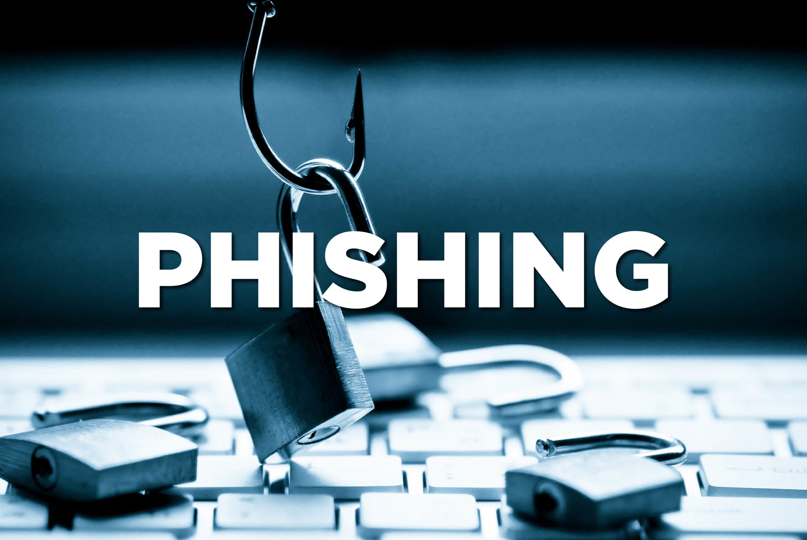
CONTENTS
Abstract
Introduction
Existing system
Disadvantages of existing system
Proposed system
Advantages of proposed system
Hardware and software requirements
Novelty
Architecture
Modules
UML Diagrams
Sample Code
Results
Conclusion
Future Scope
References
Github Link

Slide 3
ABSTRACT
Phishing is a social engineering cyberattack where criminals deceive users to obtain their credentials through a login form that submits the data to a malicious server.
we use datasets from different years to show how models decrease their accuracy over time by training a base model with old datasets and testing it with recent URLs
we have created a new dataset named Phishing Index Login URL (PILU-90K), which is composed of 60K legitimate URLs, including index and login websites, and 30K phishing URLs.
we obtains 96.50% accuracy on the introduced login URL dataset.

Slide 4

INTRODUCTION
Develop a phishing URL detection system for login pages using machine learning.
Collect and analyze datasets of legitimate and phishing URLs.
Train a model to distinguish between the two, considering common phishing tactics.
Implement a realtime analysis and alert system with a user-friendly interface.
Provide API integration and ongoing updates for adaptability.
Also we perform a frequency analysis over current phishing domains to identify different techniques carried out by phishers in their campaigns.

Slide 5
EXISTING SYSTEM
Existing system independent from third services like Google Page Rank.
They used two handcrafted feature sets, extracted from the URL and the Document Object Model (DOM) of the website.
The first set has nine legacy features including a set of keywords, while the second has eight novel features which inform of whether the website's resources are loaded using SSL protocol or not.
They used Levenshtein distance to detect typo-squatting by comparing the website and resources URLs.
These features were used to train an SVM classifier and obtained an accuracy of 90.65% on their banking websites dataset.

Slide 6
Disadvantages of Existing System
From an existing perspective, and to the best of our knowledge, publicly available datasets are not reflecting conditions that represent some real problems for phishing URL detection.
It is observed that recent machine learning proposals obtained high accuracy using outdated datasets, i.e., typically containing URLs collected from 2009 to 2017.
We demonstrate that models trained with old URLs decrease their performance when they are tested with URLs coming from recent phishing pages.

Slide 7
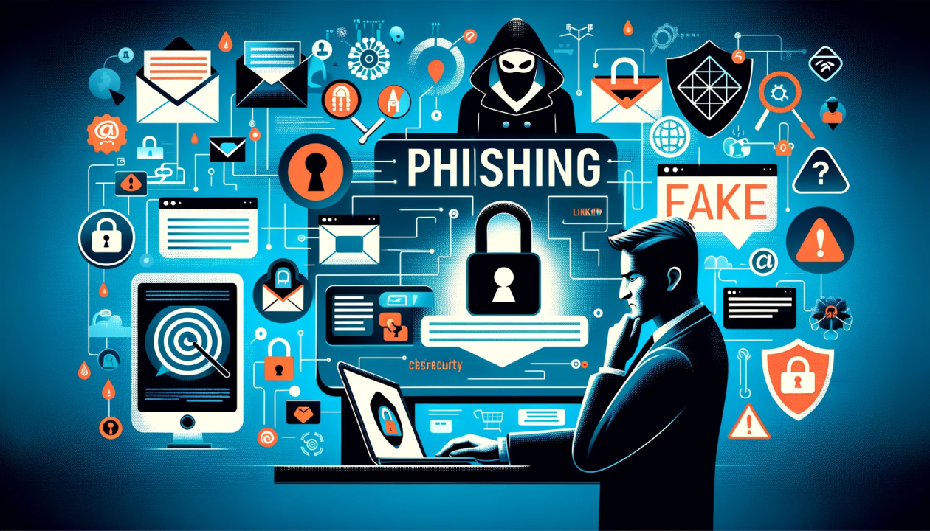
Proposed system
This project presents a phishing URL dataset using legitimate login websites to obtain the URLs from such pages.
Next, we show how models trained with legitimate homepages struggle to classify legitimate login URLs, demonstrating our hypothesis about phishing detection and legitimate login URLs.
Additionally, we show how the accuracy decrease with the time on models trained with datasets from 2016 and evaluated on data collected in 2020.
Finally, we provide an overview of current phishing encounters, explaining attacker tricks and approaches

Slide 8
Advantages of proposed system
Machine learning models to detect unreported phishing encounters.
Depending on their input data, these approaches can be classified into two categories: URL-based and content based.
Present an extended version of the Phishing Index Login URL (PILU-60K) dataset and we name it PILU-90K.
PILU-90K contains 90K URLs divided into three classes.

Slide 9

Requirements specification
Hardware requirements :
Processor: Pentium IV or higher
RAM: 256 MB
Space on Hard Disk: minimum 512MB
Software requirements :
Python
Django
MySQL
Wamp server

Slide 10
NOVELTY OF PROJECT
Uses login page URLs for both legitimate and phishing classes.
Decreases false positives associated with legitimate login pages.
Shows model accuracy decline over time, highlighting the need for updates.
Uncovers phishing tactics through domain frequency analysis.
Provides PILU-90K dataset and achieves high accuracy.

Slide 11
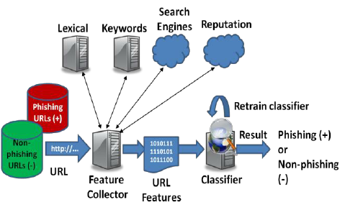
ARCHITECTURE

Slide 12
MODULES
Service Provider:
In this module, the Service Provider has to login by using valid user name and password. After login successful he can do some operations such as
Login, Train & Test URL Data Sets, View URL Data Sets Trained and Tested Accuracy in Bar Chart, View URL Data Sets Trained and Tested Accuracy Results, View Prediction Of URL Type, View URL Type Ratio , Download Predicted Data Sets, View URL Type Ratio Results, View All Remote Users.

Slide 13
Remote User:
In this module, there are n numbers of users are present. User should register before doing any operations. Once user registers, their details will be stored to the database. After registration successful, he has to login by using authorized user name and password. Once Login is successful user will do some operations like REGISTER AND LOGIN, PREDICT URL TYPE, VIEW YOUR PROFILE..
View and Authorize Users:
In this module, the admin can view the list of users who all registered. In this, the admin can view the user’s details such as, user name, email, address and admin authorizes the users.

Slide 14
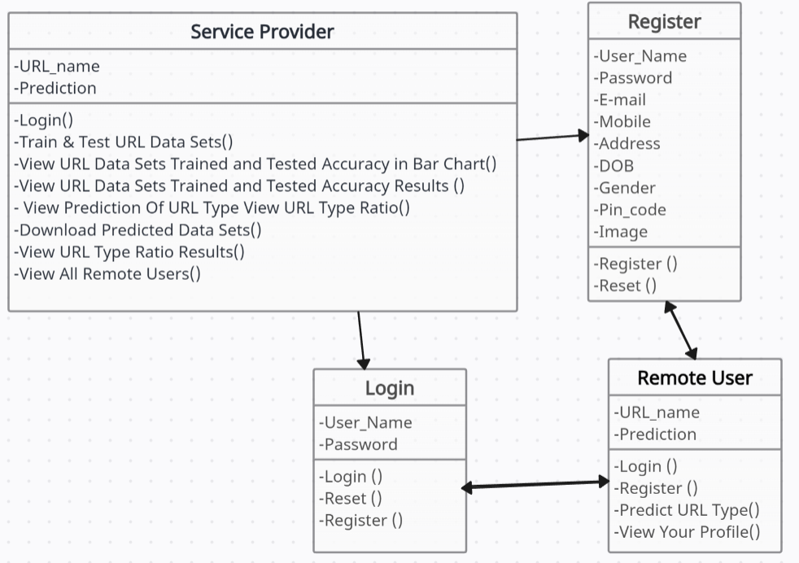
UML DIAGRAMS
CLASS DIAGRAM:

Slide 15
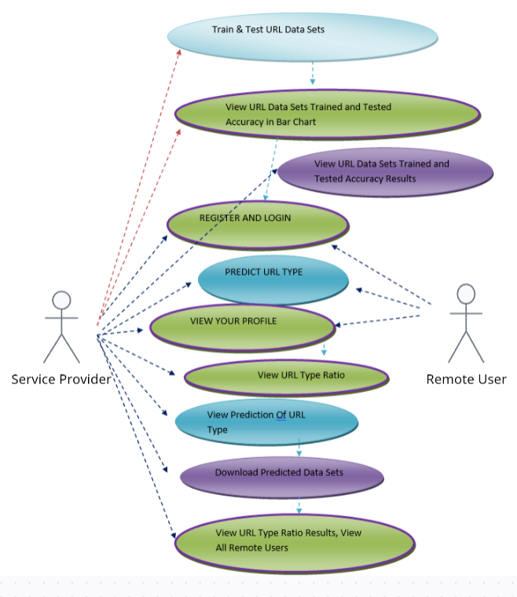
USE CASE DIAGRAM:

Slide 16
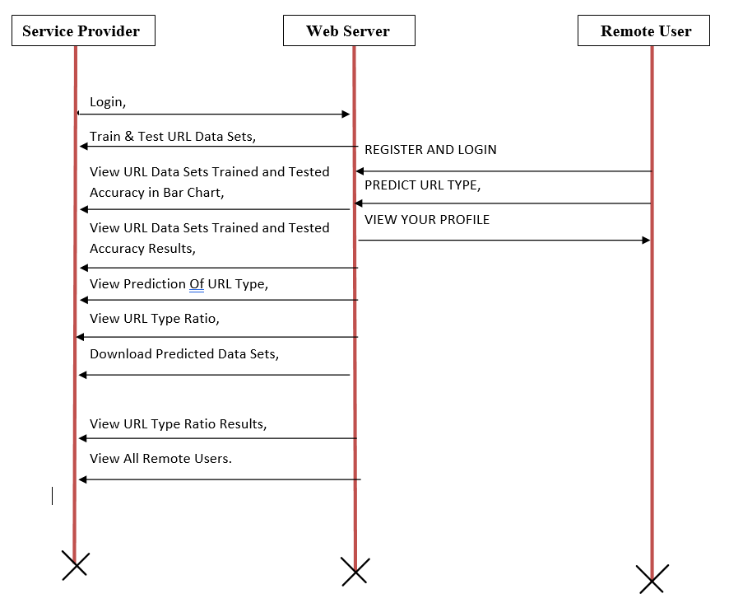
SEQUENCE DIAGRAM:

Slide 17
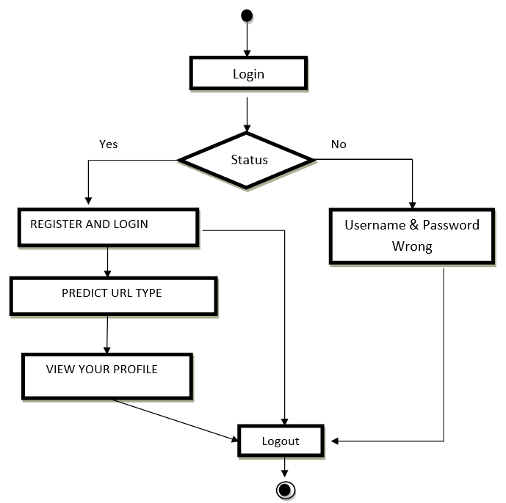
ACTIVITY DIAGRAM:

Slide 18
SAMPLE CODE
import os
import sys
def main():
"""Run administrative tasks."""
os.environ.setdefault('DJANGO_SETTINGS_MODULE', 'phishing_url_detection.settings')
try:
from django.core.management import execute_from_command_line
except ImportError as exc:
raise ImportError(
"Couldn't import Django. Are you sure it's installed and "
"available on your PYTHONPATH environment variable? Did you "
"forget to activate a virtual environment?"
) from exc
execute_from_command_line(sys.argv)
if __name__ == '__main__':
main()
from django import forms from Remote_User.models import ClientRegister_Model
class ClientRegister_Form(forms.ModelForm):
password = forms.CharField(widget=forms.PasswordInput())
email = forms.EmailField(required=True)
class Meta:
model = ClientRegister_Model
fields = ("username","email","password","phoneno","country","state","city")

Slide 19
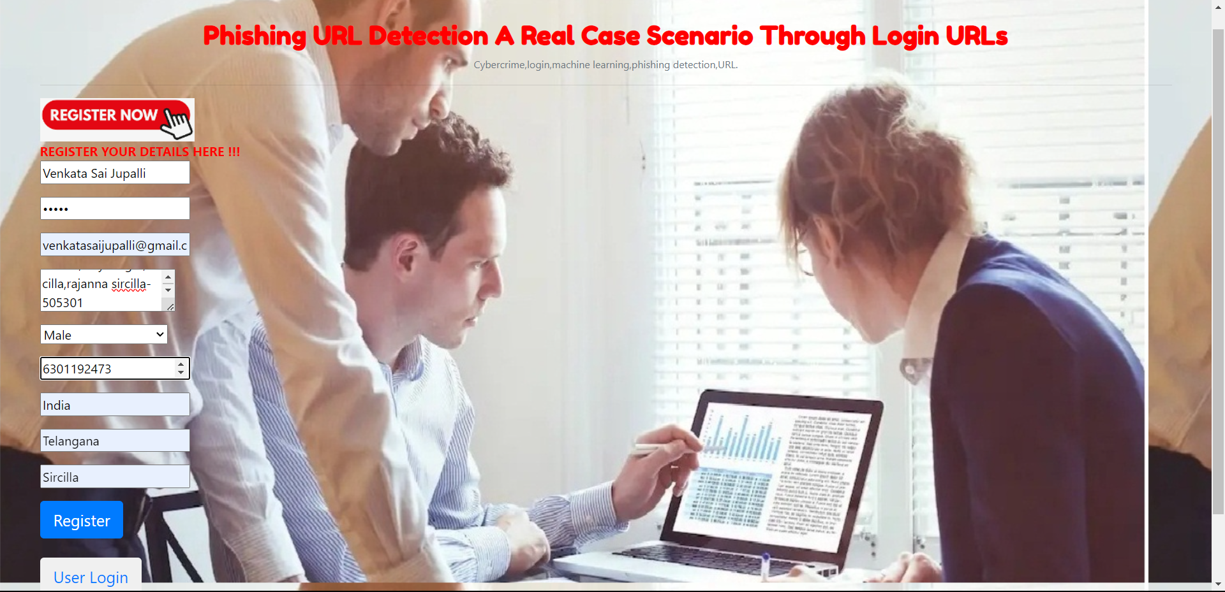
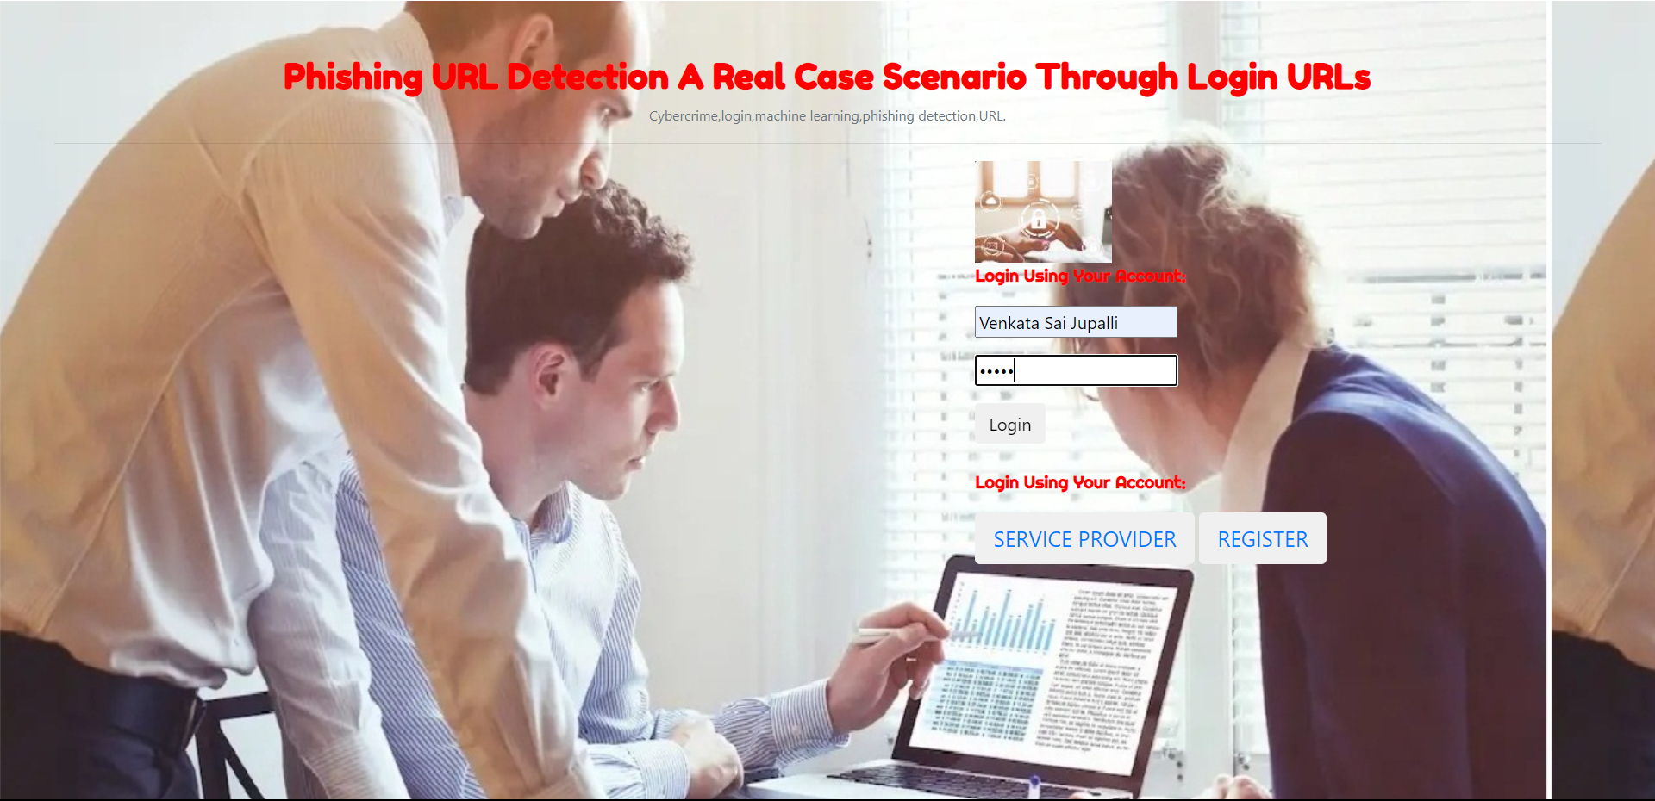
RESULTS

Slide 20
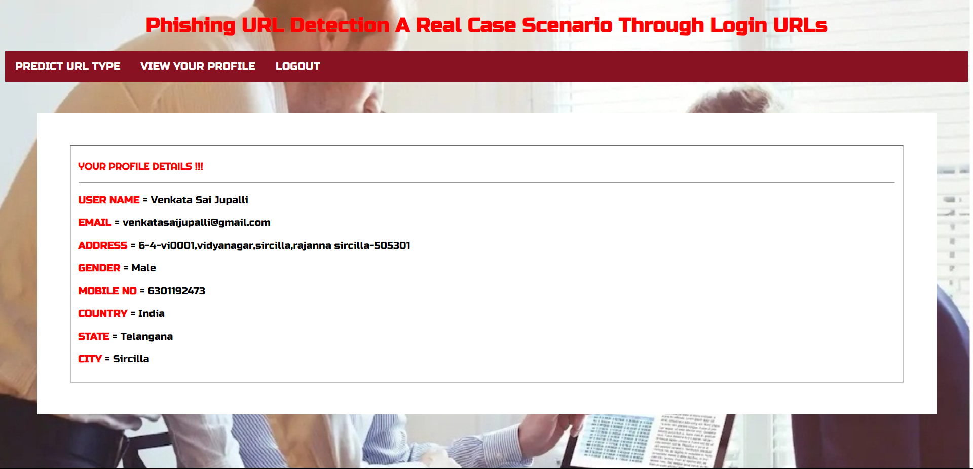
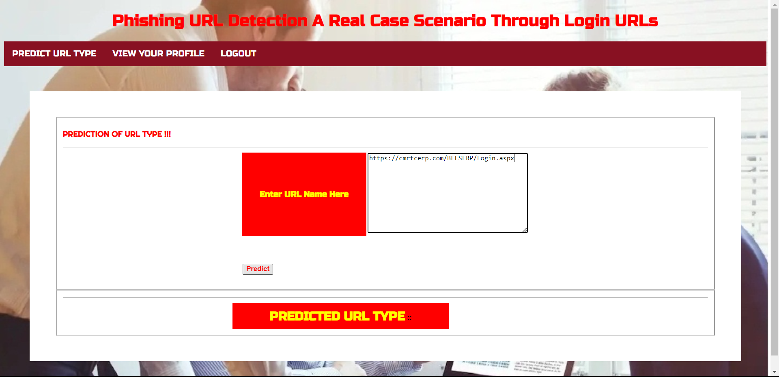

Slide 21
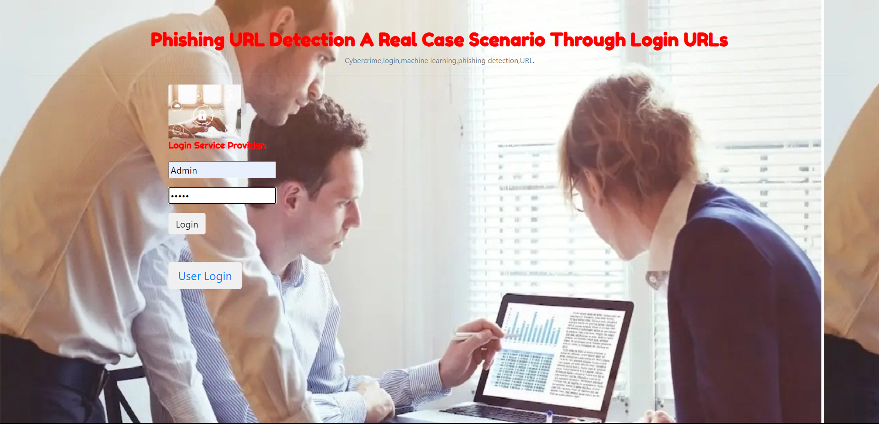
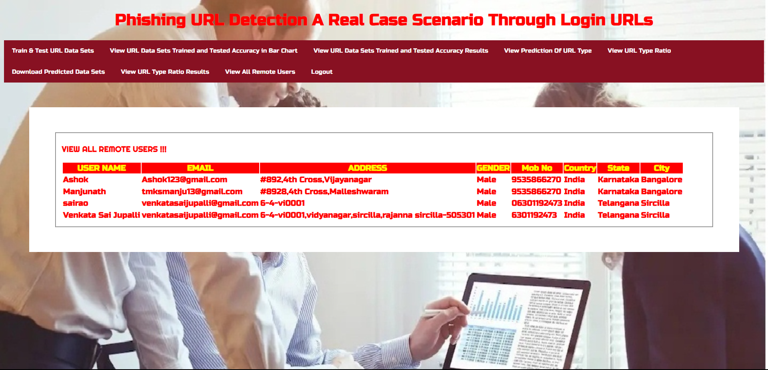

Slide 22
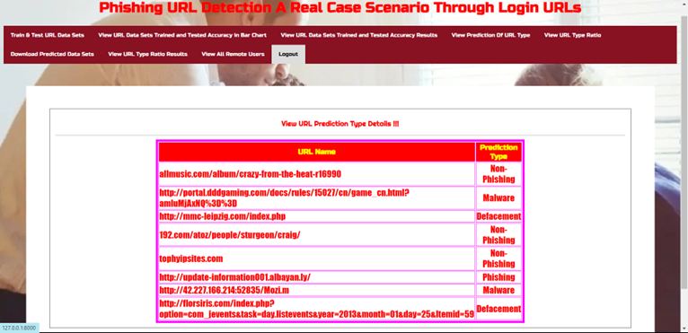
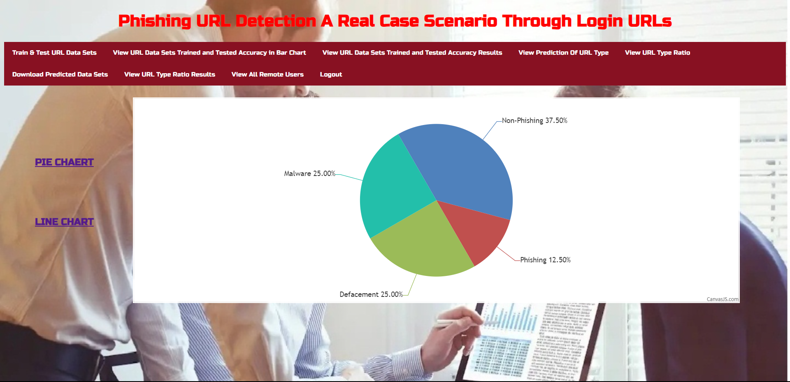

Slide 23
CONCLUSION
In conclusion, this study presents a novel approach to phishing URL detection, focusing on login pages for both legitimate and phishing classifications. By addressing false positives, showcasing temporal model accuracy trends, and uncovering phishing tactics, the research provides valuable insights. The creation of the PILU-90K dataset and the successful application of a Logistic Regression model underscore the significance of the proposed methodology in real-case scenarios.

Slide 24
FUTURE SCOPE
The feature scope encompasses a range of functionalities crucial for developing an effective phishing URL detection system. This includes analyzing URLs, employing machine learning and deep learning models for classification, utilizing various feature extraction techniques, conducting temporal analysis to detect patterns over time, analyzing phishing domains, implementing strategies for reducing false positives, managing datasets, designing user-friendly interfaces, evaluating performance metrics, integrating with existing security systems, and ensuring scalability and efficiency to handle large volumes of data in real-time or near-real-time environments. These features collectively enable the system to accurately identify phishing URLs and enhance overall cybersecurity measures.

Slide 25
REFERENCES
[1] Statista. (2020). Adoption Rate of Emerging Technologies in Organizations Worldwide as of 2020. Accessed: Sep. 12, 2021. [Online]. Available:
https://www.statista.com/statistics/661164/worldwide-cio-surveyoperati%onal-priorities/
[2] R. De', N. Pandey, and A. Pal, ``Impact of digital surge during COVID-19 pandemic: A viewpoint on research and practice,'' Int. J. Inf. Manage.,vol. 55, Dec. 2020, Art. no. 102171.
[3] P. Patel, D. M. Sarno, J. E. Lewis, M. Shoss, M. B. Neider, and C. J. Bohil,``Perceptual representation of spam and phishing emails,'' Appl. Cognit.Psychol., vol. 33, no. 6, pp. 1296_1304, Nov. 2019.
[4] J. A. Chaudhry, S. A. Chaudhry, and R. G. Rittenhouse, ``Phishing attacks and defenses,'' Int. J. Secur. Appl., vol. 10, no. 1, pp. 247_256, 2016.
[5] M. Hijji and G. Alam, ``A multivocal literature review on growing social engineering based cyber-attacks/threats during the COVID-19 pandemic: Challenges and prospective solutions,'' IEEE Access, vol. 9,pp. 7152_7169, 2021.
[6] A. Alzahrani, ``Coronavirus social engineering attacks: Issues and recommendations,'' Int. J. Adv. Comput. Sci. Appl., vol. 11, no. 5,pp. 154_161, 2020.
[7] Phishing Activity Trends Report 3Q, Anti-Phishing Working Group, International, 2017. Accessed: Sep. 12, 2021.

Slide 26
GITHUB LINK
https://github.com/venkatasairao/Phishing_URL_Detection-A_Real_Case_Scenario_Through_Login_URLs

Slide 27

Thank you..!

